Slide 1
Sensor:
Capacitance probe
Apply moving average,
and differentiate to
calculate velocity
P(s)
-
C(s)
P(s)
PID
sensor

Slide 2
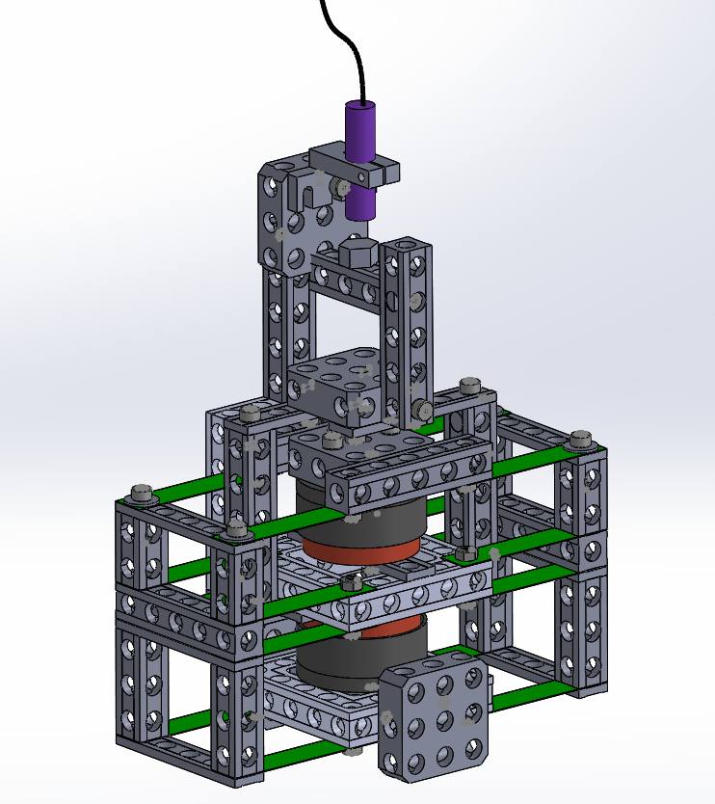
Capacitance probe
frame
reference surface for
Capacitance probe
translating stage
platform to place mass
frame
frame
(b)
flexure leaf
voltage/velocity ratio mode
Force/current ratio mode
translating stage
Coil A
Coil B
magnet
Coil B
frame
Coil B
(c)
(a)

Slide 5
